Slide 1
Network+ Guide to Networks Eighth Edition
Chapter 7
Virtualization and Cloud Computing
© 2019 Cengage. All Rights Reserved. May not be copied, scanned, or duplicated, in whole or in part, except for use as permitted in a license distributed with a certain product or service or otherwise on a password-protected website for classroom use.

Slide 2
Objectives
7.1 Describe and explain virtualization technologies, including how virtual machines connect with a network and how networking infrastructure devices can be virtualized
7.2 Describe cloud computing categories and models, and discuss concerns regarding cloud connectivity and security
7.3 Secure network connections using encryption protocols
7.4 Configure remote access connections between devices

Slide 3
Virtualization (1 of 5)
Virtualization
A virtual, or logical, version of something rather than the actual, or physical, version
Host
Physical computer “hosting” a virtual machine
Guest
Each virtual machine
Hypervisor
Creates and manages a V M
Manages resource allocation and sharing between a host and any of its guest V Ms

Slide 4
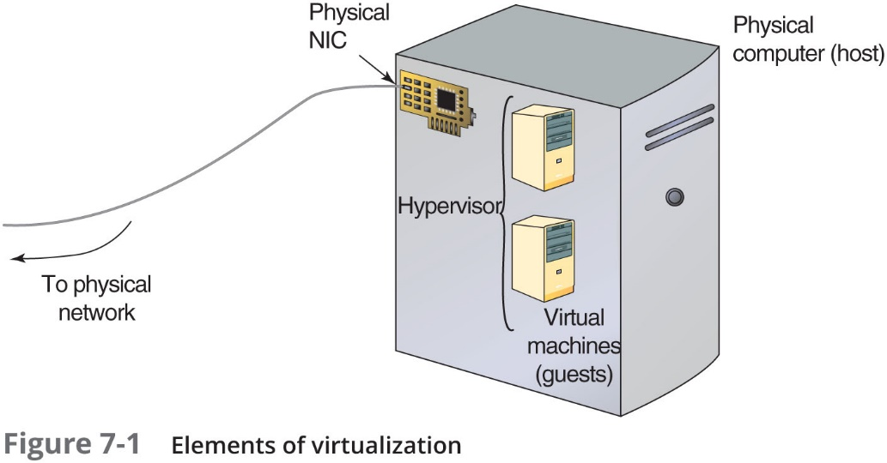
Virtualization (2 of 5)

Slide 5
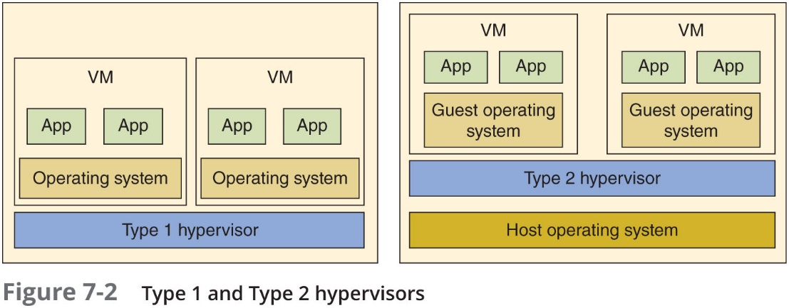
Virtualization (3 of 5)
Two types of hypervisors:
Type 1—Installs on a computer before any O S and is called a bare-metal hypervisor
Type 2—Installs in a host O S as an application and is called a hosted hypervisor

Slide 6
Virtualization (4 of 5)
A V M’s software and hardware characteristics are assigned when it is created in they hypervisor
You can customize the V M with:
A guest O S
Amount of memory
Hard disk size
Processor type and other options

Slide 7
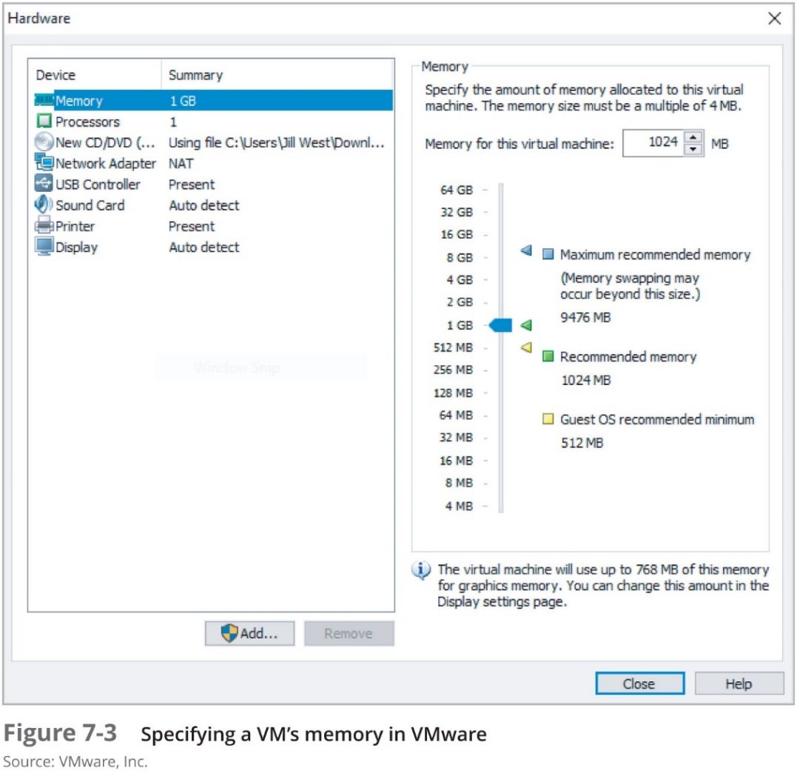
Virtualization (5 of 5)

Slide 8
Network Connection Types (1 of 9)
Every V M has its own v N I C (virtual N I C):
Can connect the V M to other machines
Operates at the Data Link layer
Each V M can have several v N I Cs
Maximum number depends on the limits imposed by the hypervisor
When V M’s v N I C is selected:
Hypervisor creates a connection between that V M and the host
Connection might be called a bridge or switch (vSwitch)
One host can support multiple virtual switches
Controlled by the hypervisor

Slide 9
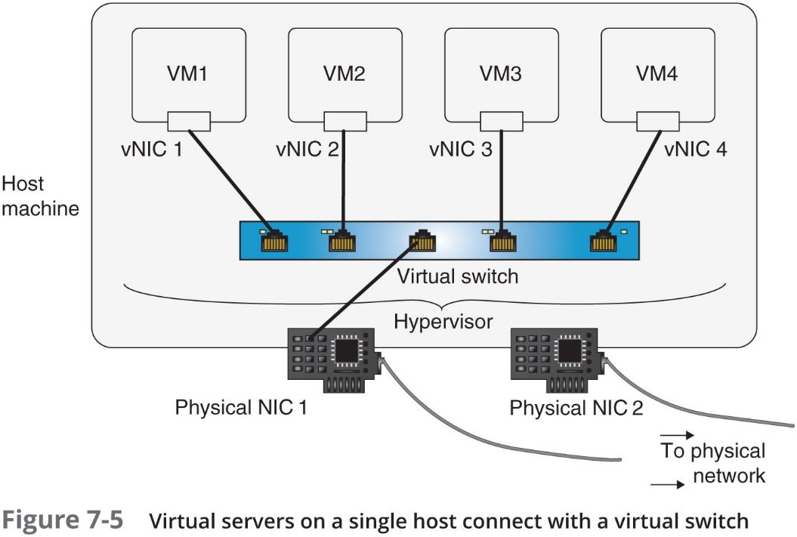
Network Connection Types (2 of 9)

Slide 10
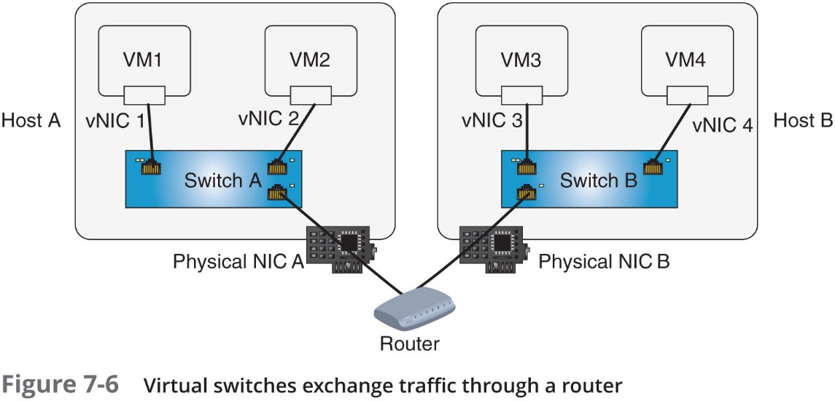
Network Connection Types (3 of 9)
The way a v N I C is configured determines whether the V M is joined to a virtual network or attempts to join the physical LAN the host machine is connected to
Various configurations are called networking modes, the most common are:
Bridged
N A T
Host-only

Slide 11
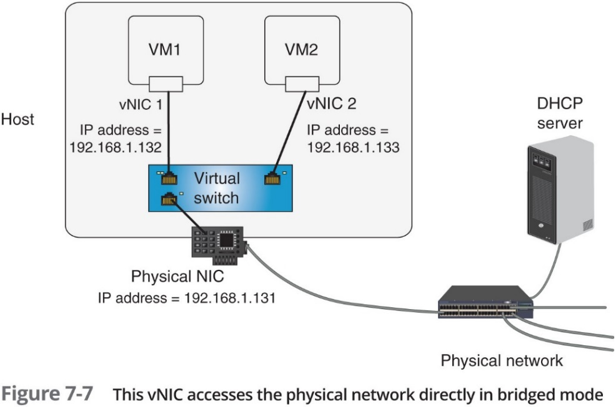
Network Connection Types (4 of 9)
Bridged mode:
v N I C accesses physical network using host machine’s N I C
Obtains own I P address, default gateway, and netmask from D H C P server on physical LAN
VM appears to other nodes as just another client or server on the network

Slide 12
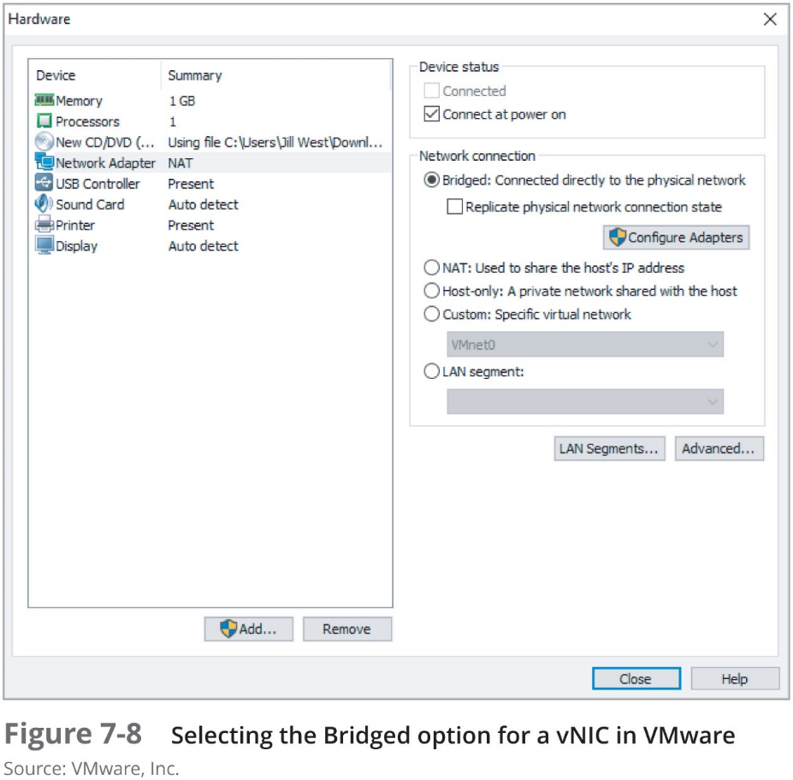
Network Connection Types (5 of 9)

Slide 13
Network Connection Types (6 of 9)
N A T mode:
v N I C relies on host machine to act as N A T device
Obtains I P addressing information from host
Hypervisor acts as a D H C P server
Appropriate for V Ms that do not need to be accessed at a known address by other network nodes

Slide 14
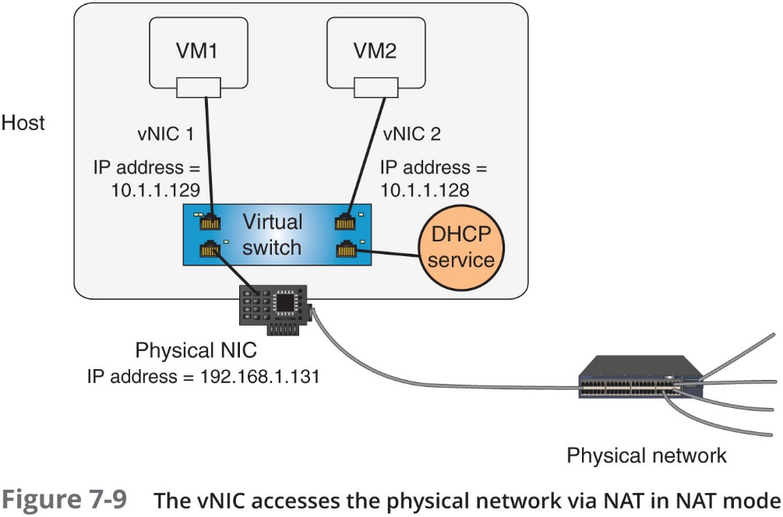
Network Connection Types (7 of 9)

Slide 15
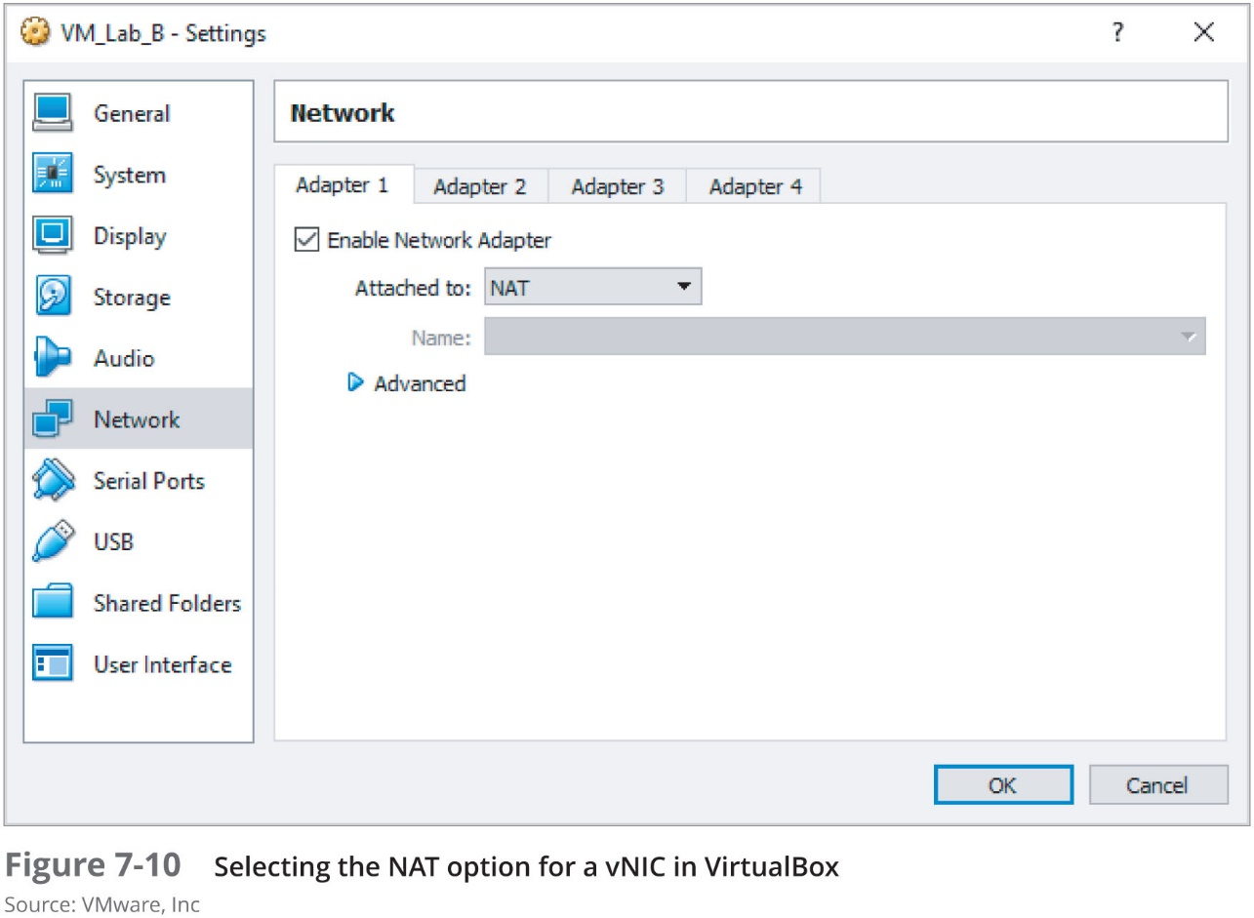
Network Connection Types (8 of 9)

Slide 16
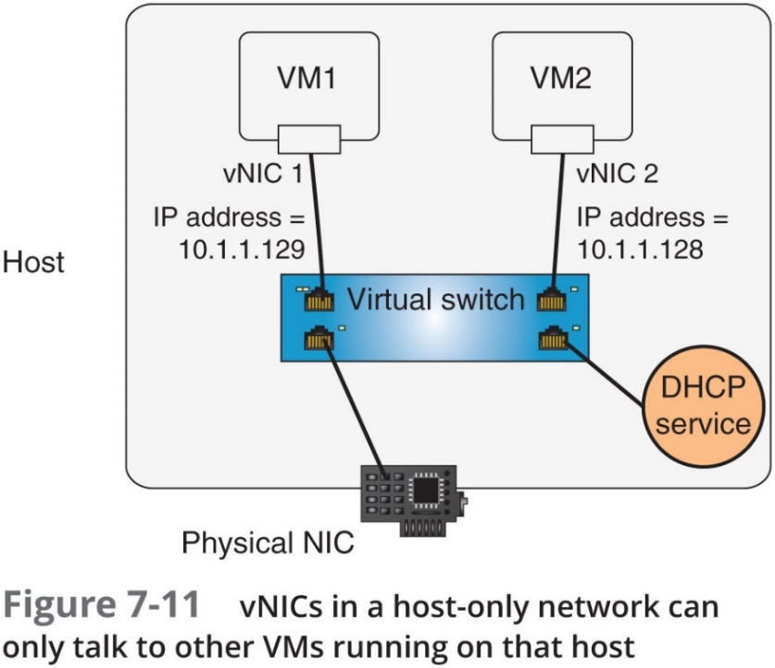
Network Connection Types (9 of 9)
Host-only mode:
V Ms on one host can exchange data with each other and the host
Cannot communicate with nodes beyond the host
Never receive or transmit data with host’s physical N I C

Slide 17
Pros and Cons of Virtualization
Advantages of virtualization:
Efficient use of resources
Cost and energy savings
Fault and threat isolation
Simple backups, recovery, and replication
Disadvantages:
Compromised performance
Increased complexity
Increased licensing costs
Single point of failure

Slide 18
N F V (Network Functions Virtualization) (1 of 2)
Options for virtualizing network devices:
Virtual firewall—Install a firewall’s O S in a V M on an inexpensive server
Virtual router—Install a router VM on a server instead of purchasing an expensive hardware router
Advantages of virtualizing network functions:
Virtual devices can be quickly and sometimes automatically migrated (moved) from one server to another in the event of hardware failure of maintenance
Resources are utilized more efficiently
Services can be easily scaled to meet the changing needs of a network

Slide 19
N F V (Network Functions Virtualization) (2 of 2)
N F V (Network Functions Virtualization):
Merging physical and virtual network architectures
Provides flexible, cost-saving options for many types of network devices including:
Virtual servers
Data storage
Load balancers
Firewall
Keep in mind:
You will need licenses for each virtualized device
Interaction between physical and virtual devices introduces a small degree of latency
Some administrators are not comfortable using a virtual firewall to protect an entire network

Slide 20
S D N (Software-Defined Networking) (1 of 4)
S D N:
The virtualization of network services
An S D N controller (or network controller) manages these services instead of services being directly managed by hardware devices
S D N controller integrates all of the network’s virtual and physical devices into one cohesive system
Protocols handle the process of making decisions (called the control plane)
Physical devices make actual contact with data transmissions as they traverse the network (called the data plane)

Slide 21
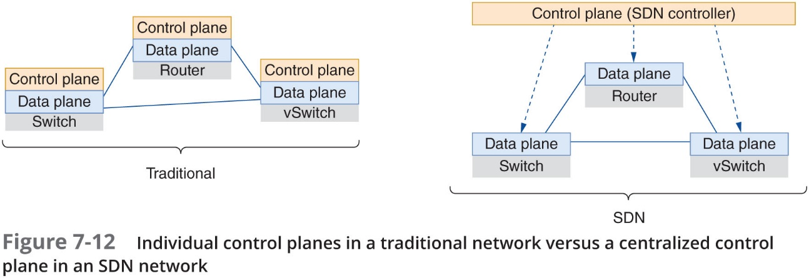
S D N (Software-Defined Networking) (2 of 4)

Slide 22
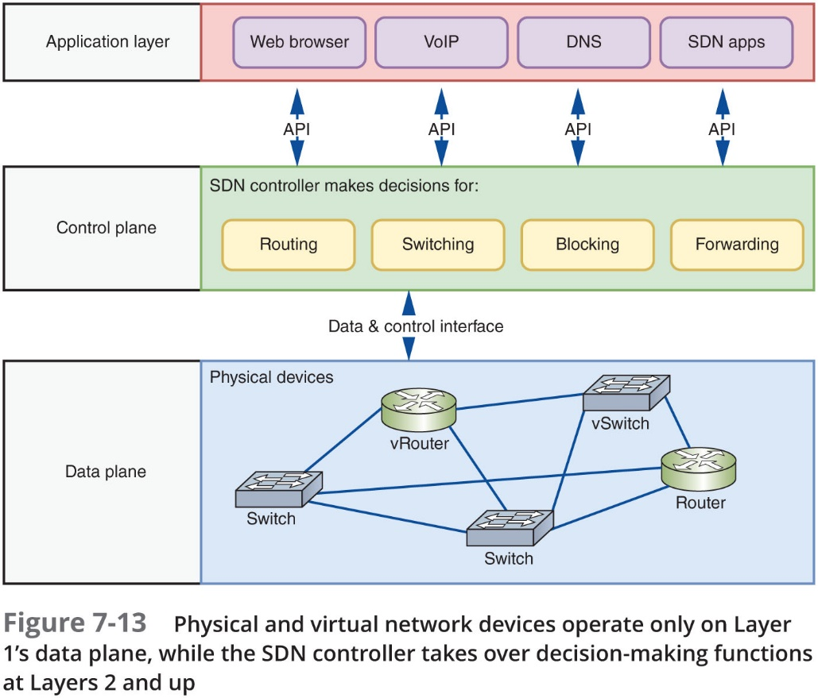
S D N (Software-Defined Networking) (3 of 4)

Slide 23
S D N (Software-Defined Networking) (4 of 4)
Primary advantage to separating the control plane from the data plane
To provide network technicians with more centralized control of network settings and management
S D N creates the potential to implement more sophisticated network functions while using less-expensive devices
S D N architecture has been expanding to include management of network resources hosted in places other than an organization’s own network

Slide 24
Cloud Computing (1 of 3)
Internet is frequently pictured as a cloud
Cloud computing
Flexible provision of data storage, applications, and services to multiple clients over a network
Cloud computing features:
On-demand service
Support for multiple platforms
Resource pooling and consolidation
Metered service
Elastic services and storage
Storage capacity can quickly or automatically be scaled up or down

Slide 25
Cloud Computing (2 of 3)
Can provide virtual desktops
Operating environments hosted virtually
Developers can load any kind of software on the servers and test it from afar
Cloud services provider can make sure the development servers are secure and regularly backed up
Most cloud service providers use virtualization software to supply multiple platforms to multiple users

Slide 26
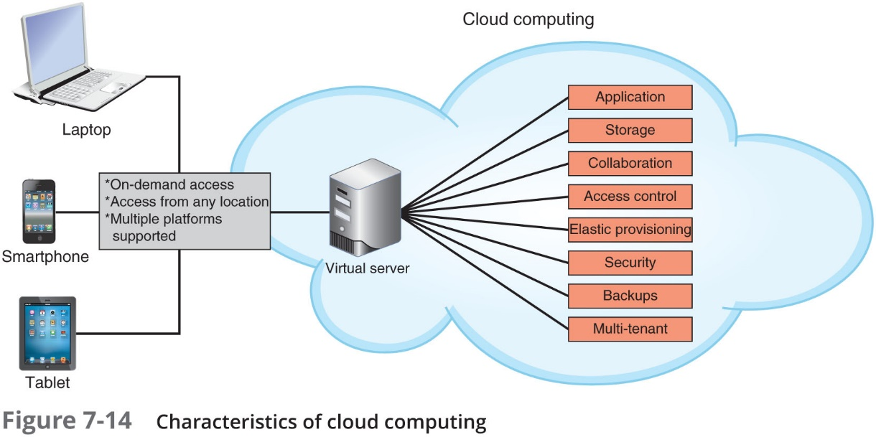
Cloud Computing (3 of 3)

Slide 27
Cloud Computing Categories (1 of 4)
Cloud computing service models are categorized by the types of services provided:
Traditional
All hardware, software, and everything else is located and managed at the organization’s location
I a a S (Infrastructure as a Service)
Hardware services and network infrastructure devices are provided virtually
Including end user interfaces such as H V Ds (hosted virtual desktops)
P a a S (Platform as a Service)
O S, runtime libraries or modules the OS provides to applications, and the hardware on which the O S runs
S a a S (Software as a Service)
Applications

Slide 28
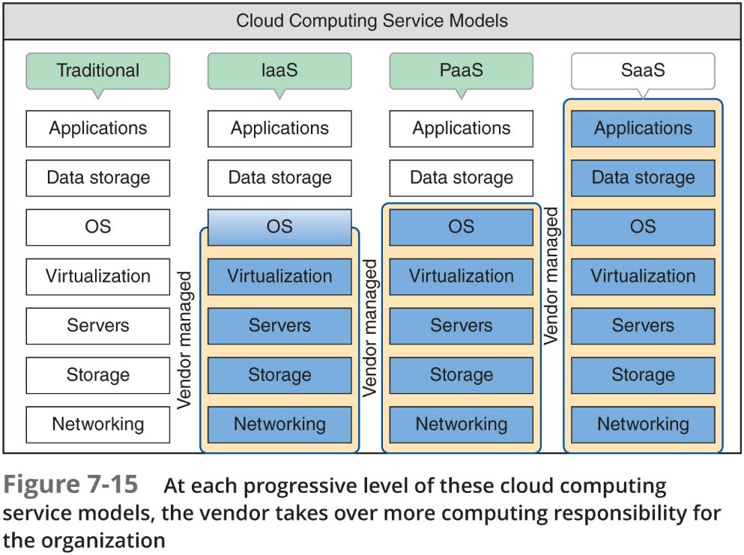
Cloud Computing Categories (2 of 4)

Slide 29
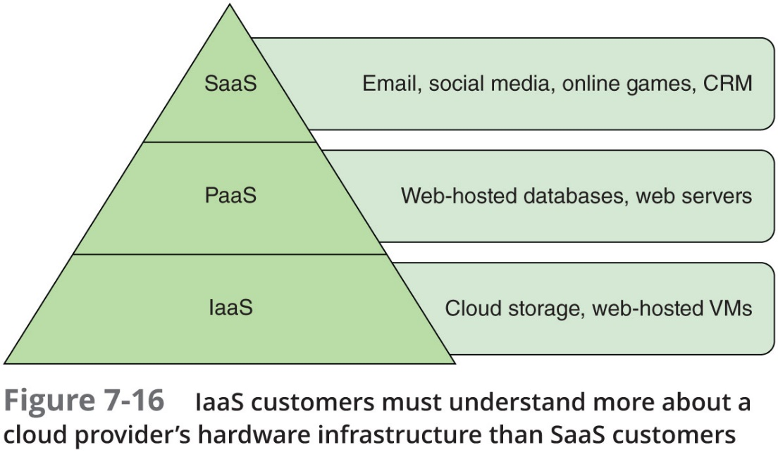
Cloud Computing Categories (3 of 4)
X a a S (Anything as a Service or Everything as a Service):
A broader model
Cloud can provide any combination of functions

Slide 30
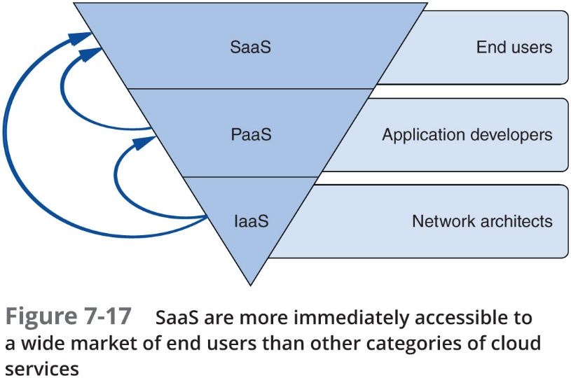
Cloud Computing Categories (4 of 4)

Slide 31
Deployment Models
Cloud services are delivered in a variety of deployment models
Public cloud
Service provided over public transmission lines
Private cloud
Service established on an organization’s own servers in its own data center
Community cloud
Service shared between multiple organizations
Hybrid cloud
Combination of the other service models into a single deployment

Slide 32
Cloud Connectivity and Security (1 of 2)
Potential risks and limitations:
I S P’s uptime
I S P-imposed bandwidth limitations
Cloud provider’s uptime
Cloud provider’s backup and security systems
Misconfiguration that exposes one client’s data to another client
Unauthorized access to data by cloud provider employees or illegitimate users
Breaches of confidentiality
Data security regulations
Questions over ownership of intellectual property stored in the cloud
Questions over data maintenance

Slide 33
Cloud Connectivity and Security (2 of 2)
Potential risks and limitations (continued):
Risks to the network, proprietary data, or customer information caused by B Y O C (bring your own cloud) services on user’s personal devices
Reduced consumer confidence, fines, lawsuits, and possibly criminal charges when cloud breaches occur
Way to reduce risks of cloud computing:
Use encryption
Carefully choose the method by which your network connects to your cloud resources:
Internet
Remote access connections
Leased line
Dedicated connection

Slide 34
Encryption Protocols
Encryption:
Use of mathematical code, called a cipher, to scramble data into a format that can be read only by reversing the cipher
Used to keep information private
Primarily evaluated by three benchmarks:
Confidentiality
Integrity
Availability
The principles above form the standard security model called the C I A triad

Slide 35
Key Encryption (1 of 3)
Key:
Random string of characters
Woven into original data’s bits
Generates unique data block called ciphertext
Created according to a specific set of rules (algorithms)
Key encryption can be separated into two categories:
Private key encryption
Public key encryption

Slide 36
Key Encryption (2 of 3)
Private key encryption:
Data encrypted using single key
Known only by sender and receiver
Symmetric encryption
Same key used during both encryption and decryption
Public key encryption:
Data encrypted using two keys
Private key: user knows
Public key: anyone may request
Public key server:
Publicly accessible host
Freely provides users’ public keys

Slide 37
Key Encryption (3 of 3)
Key pair
Combination of public and private keys
Asymmetric encryption
Requires two different keys
Digital certificate
Holds identification information and the user’s public key
C A (certificate authority)
Issues, maintains digital certificates
P K I (Public key Infrastructure)
Use of certificate authorities to associate public keys with certain users

Slide 38
I P sec (Internet Protocol Security)
I P sec
Encryption protocol suite that defines rules for encryption, authentication, and key management for T C P/I P transmissions
I P sec creates secure connections in five steps:
IPsec initiation
Key management
Security negotiations
Data transfer
Termination
Operates in two modes:
Transport mode
Tunnel mode

Slide 39
S S L (Secure Sockets Layer) and T L S (Transport Layer Security) (1 of 2)
Both are methods of encrypting T C P/I P transmissions
Including Web pages and data entered into Web forms
Both protocols work side by side and are widely known as S S L/T L S or T L S/S S L
When a client and server establish a S S L/T L S connection, they establish a unique session
Association between client and server
Defined by agreement
Specific set of encryption techniques
Created by S S L handshake protocol
Handshake protocol
Allows client and server to authenticate
Similar to a T C P three-way handshake

Slide 40
S S L (Secure Sockets Layer) and T L S (Transport Layer Security) (2 of 2)
D T L S (Datagram Transport Layer Security)
A variant of T L S
Designed specifically for streaming communications
Applications using D T L S must provide their own means of:
Packet reordering
Flow control
Reliability assurance
D T L S includes security levels that are compatible to T L S
D T L S is commonly used by delay-sensitive applications
Such as V o I P and tunneling applications

Slide 41
Remote Access (1 of 4)
Remote access:
Service that allows a client to connect with and log on to a server, LAN, or WAN in a different geographical location
Requires a type of R A S (remote access server)
Two types of remote access servers:
Dedicated devices
Software running on a server

Slide 42
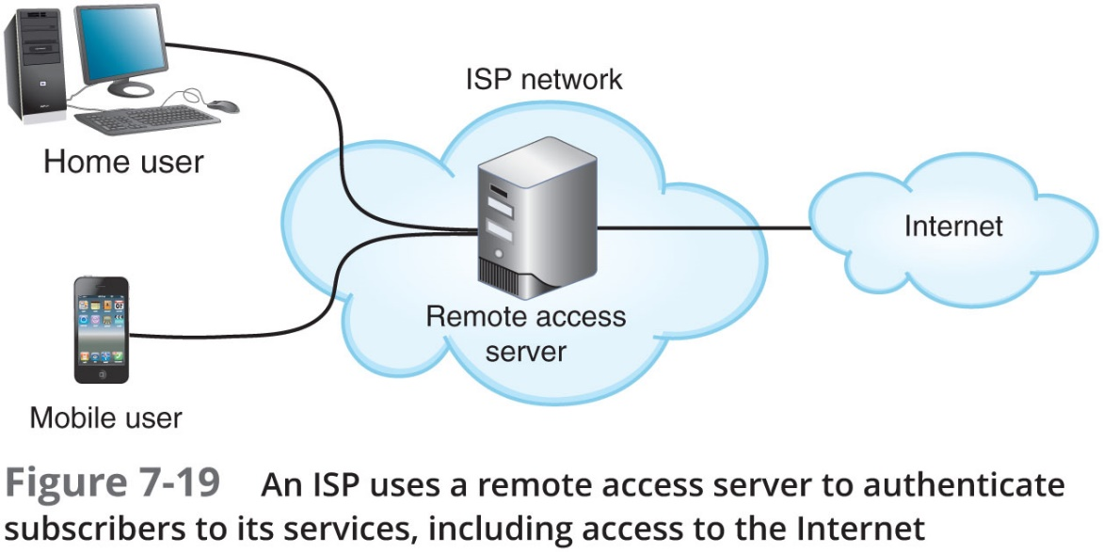
Remote Access (2 of 4)

Slide 43
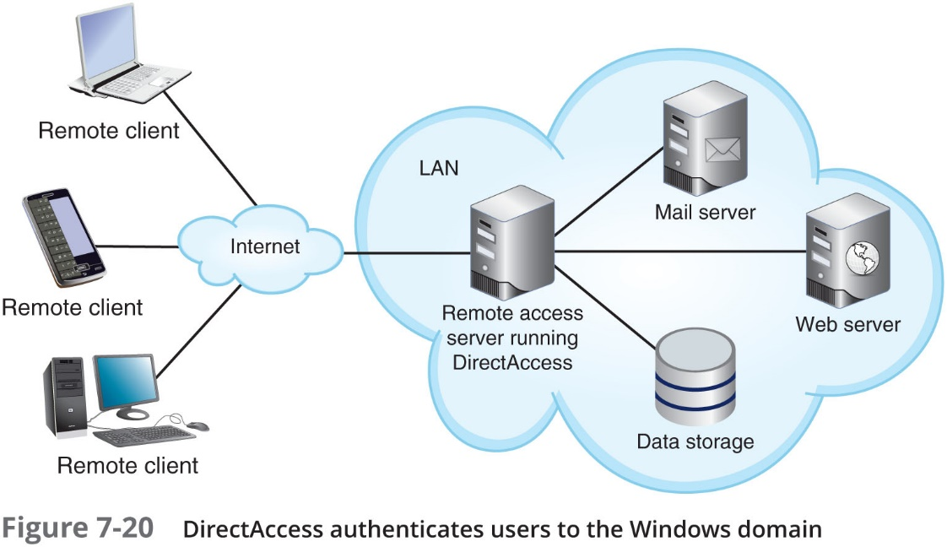
Remote Access (3 of 4)

Slide 44
Remote Access (4 of 4)
Types of remote access:
Point-to-point over a dedicated line
Terminal emulation, also called remote virtual computing
Virtual private network (V P N)
Data is often encrypted before it is transmitted over the remote connection:
Some remote access protocols natively include encryption functionality
Others must be paired with a specific encryption protocol

Slide 45
Point-to-Point Remote Access Protocols
An older protocol known as SLIP has been replaced by P P P as the preferred communications protocol for remote access point-to-point connections
P P P (Point-to-Point Protocol)
A Data Link layer protocol that directly connects two WAN endpoints
P P P can:
Negotiate and establish a connection between two computers
Use an authentication protocol to authenticate a client to a remote system
Support several types of Network layer protocols
Encrypt the transmissions, although P P P encryption is considered weak by today’s standards

Slide 46
Terminal Emulation (1 of 7)
Terminal emulation (remote virtual computing)
Allows a user on one computer to control another computer across a network connection
Examples of command-line software:
Telnet and S S H
Examples of G U I-based software:
Remote Desktop for Windows
join.me
V N C
Team Viewer

Slide 47
Terminal Emulation (2 of 7)
Telnet:
A terminal emulation utility that allow an administrator or other user to control a computer remotely
Provides little security for establishing a connection (poor authentication)
Provides no security for transmitting data (no encryption)
S S H (Secure Shell):
A collection of protocols that provides for secure authentication and encryption
Guards against a number of security threats:
Unauthorized access to a host
I P spoofing
Interception of data in transit
D N S spoofing

Slide 48
Terminal Emulation (3 of 7)
S S H (continued):
Developed by S S H Communications Security
Version requires license fee
Open source versions available: Open S S H
Secure connection requires S S H running on both client and server
Allows for password authentication using public and private key generation
Configuration options:
Use one of several encryption types
Require client password
Perform port forwarding
Redirect traffic that would normally use an insecure port to a S S H-secured port

Slide 49
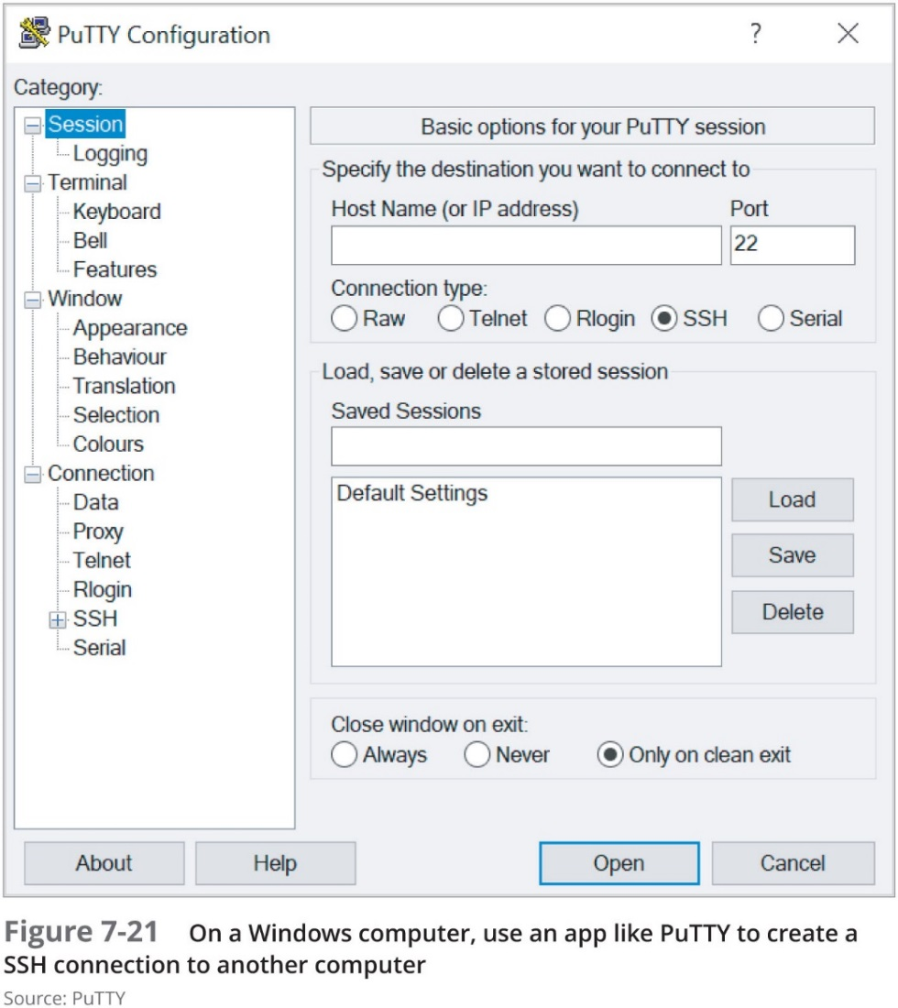
Terminal Emulation (4 of 7)

Slide 50
Terminal Emulation (5 of 7)
R D P (Remote Desktop Protocol) and V N C (Virtual Network Computing)
R D P is a Microsoft proprietary protocol used to connect to and control a remote computer
V N C uses the cross-platform protocol R F B (remote frame buffer) to remotely control a workstation or server
V N C is open source so many companies have developed their own software that can:
Run O S es on client computers
Remotely access computers, tablets, and smartphones
Remotely control media equipment and surveillance systems

Slide 51
Terminal Emulation (6 of 7)
Management U R L using H T T P S:
Networking devices are being configured through a connected computer’s browser that navigates to a management U R L
User can make changes directly to the device
Ideally the devices will require encrypted connection over H T T P S
Out-of-band management:
Relies on a dedicated connection between the network administrator’s computer and each network device
A remote management card is attached to the network device’s console port
Or sometimes it is built into the device
A single device, such as a console server or console router, provides centralized management of all linked devices

Slide 52
Terminal Emulation (7 of 7)
Remote file access:
F T P (File Transfer Protocol) is not a form of terminal emulation but it does provide remote file access
Technologies related to F T P:
F T P S (F T P Security or F T P Secure)
S F T P (Secure F T P)
T F T P (Trivial F T P)

Slide 53
V P Ns (Virtual Private Networks) (1 of 6)
V P N:
A network connection encrypted from end to end that creates a private connection to a remote network
Sometimes referred to as a tunnel
V P Ns can be classified according to three models:
Site-to-site V P N
Client-to-site V P N
Also called host-to-site V P N or remote-access V P N
Host-to-host V P N

Slide 54
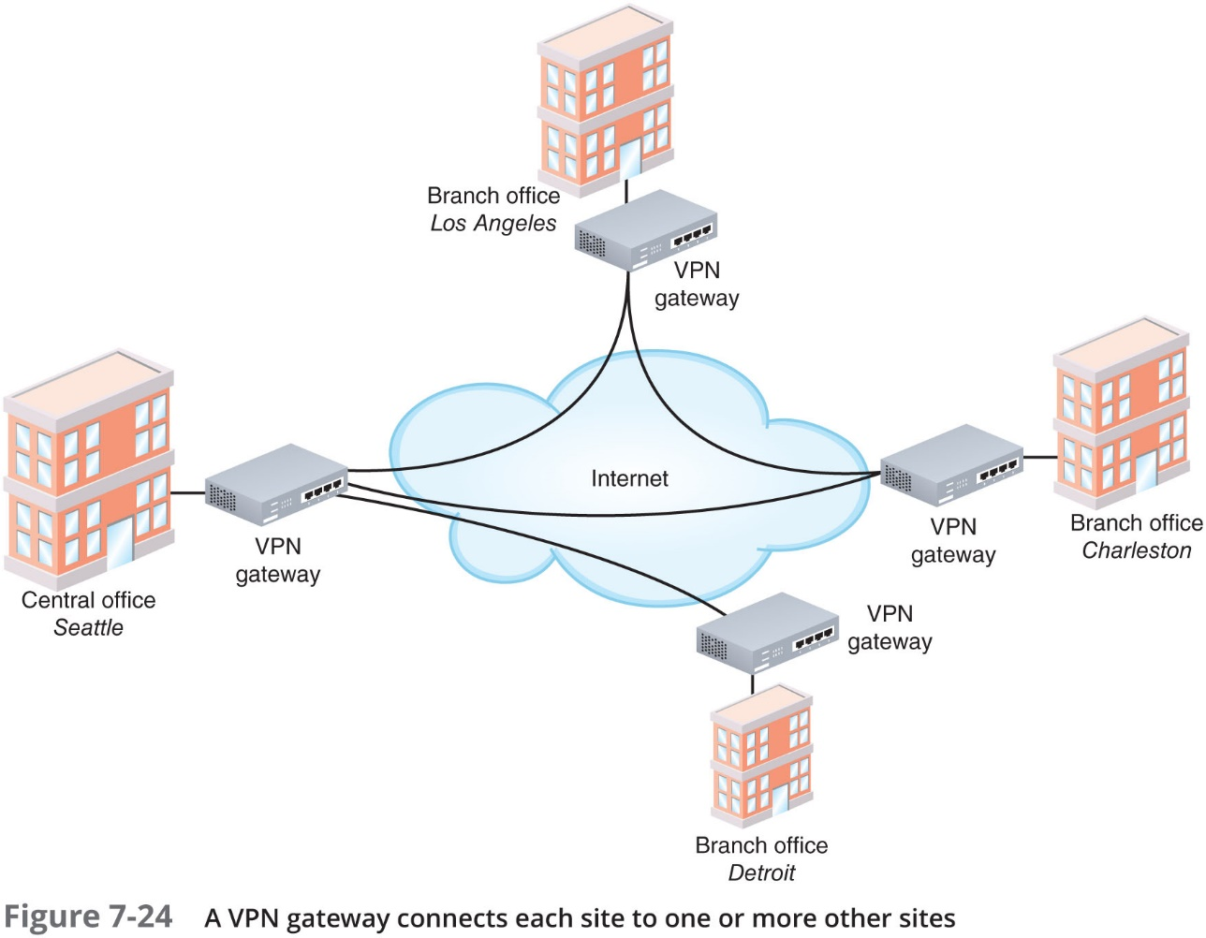
V P Ns (Virtual Private Networks) (2 of 6)

Slide 55
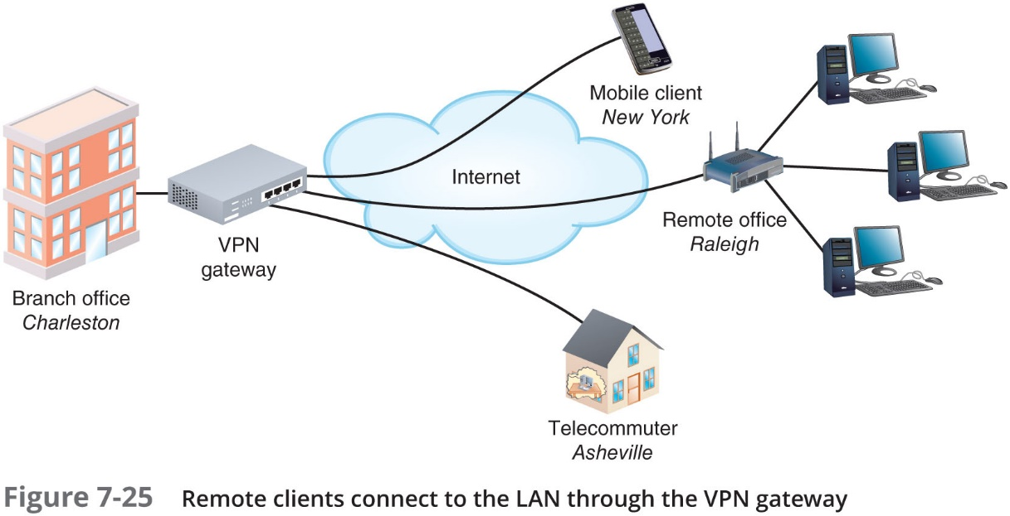
V P Ns (Virtual Private Networks) (3 of 6)

Slide 56
V P Ns (Virtual Private Networks) (4 of 6)
A router-based V P N is the most common implementation on UNIX-based networks
Server-based V P Ns are most often found on Windows networks
V P N concentrator:
Authenticates V P N clients
Establishes tunnels for V P N connections
Manages encryption for V P N transmissions
Two primary encryption techniques used by V P Ns:
I P sec
S S L

Slide 57
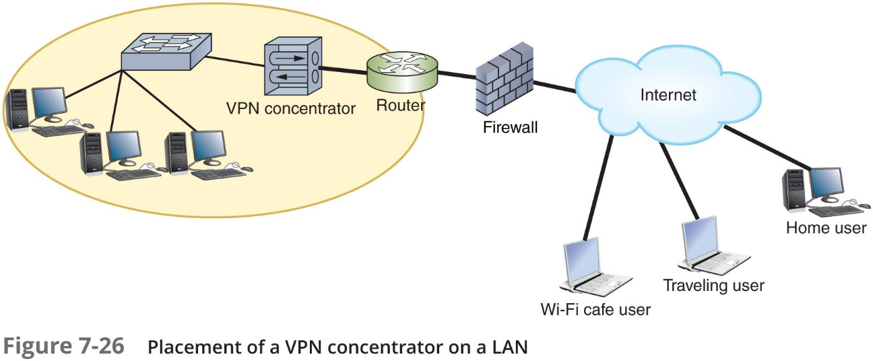
V P Ns (Virtual Private Networks) (5 of 6)

Slide 58
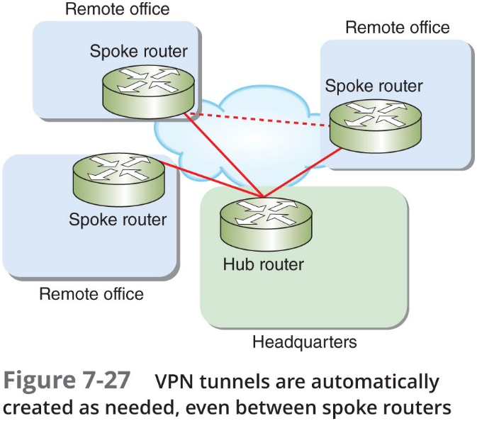
V P Ns (Virtual Private Networks) (6 of 6)
An enterprise-wide V P N can include elements of both client-to-site and site-to-site models
D M V P N (Dynamic Multipoint V P N)
A type of enterprise using Cisco devices
Dynamically creates V P N tunnels between branch locations as needed
Instead of requiring constant, static tunnels for site-to-site connections

Slide 59
V P N Tunneling Protocols (1 of 4)
To ensure V P Ns can carry all types of data securely
Special V P N protocols encapsulate higher-layer protocols in a process known as tunneling
Many V P N tunneling protocols operate at the Data Link layer
Encapsulate the V P N frame into a Network layer packet
Some V P N tunneling protocols work at Layer 3
Enables additional features and options
Most tunneling protocols rely on an additional encryption protocol to provide data security

Slide 60
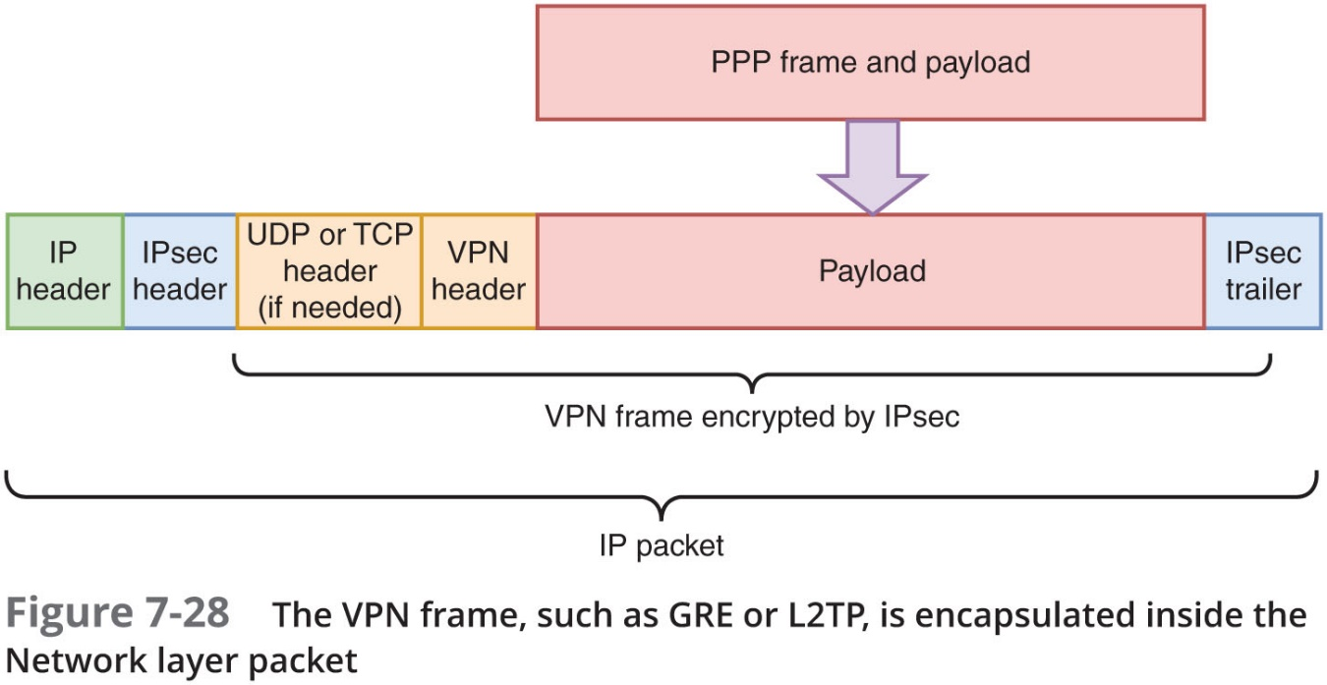
V P N Tunneling Protocols (2 of 4)

Slide 61
V P N Tunneling Protocols (3 of 4)
P P T P (Point-to-Point Tunneling Protocol):
An older Layer 2 protocol that supports encryption, authentication, and access services provided by the V P N server
Uses T C P segments at the Transport layer
Outdated and is no longer considered secure
L2 T P (Layer 2 Tunneling Protocol):
Encapsulates P P P data in a similar manner to P P T P
Can connect a V P N that uses a mix of equipment types
It is a standard accepted and used by multiple vendors
Can connect two routers, a router and a R A S, or a client and a R A S
Implemented with IPsec for security

Slide 62
V P N Tunneling Protocols (4 of 4)
G R E (Generic Routing Encapsulation):
Used to transmit P P P, IP and other kinds of messages through the tunnel
Used in conjunction with IPsec
Open V P N
Open-source V P N protocol that uses a custom security protocol called OpenSSL for encryption
I K E v 2:
A component of the IPsec protocol suite
Offers fast throughput and good stability when moving between wireless hotspots

Slide 63
Remote Access Policies (1 of 2)
Common requirements:
Devices used for remote access must be kept up to date with patches, anti-malware software, and a firewall
Device access must be controlled by a strong password or biometric measures
Passwords must be strong and must be changed periodically
The device’s internal and external storage devices must be encrypted
Company and customer data that is accessed, transferred, stored, or printed must be kept secure
The loss or theft of any devices used for remote access must be reported to the company immediately

Slide 64
Remote Access Policies (2 of 2)
Common requirements (continued):
Encrypted V P N software must be used to remotely access company network resources
While remotely connected to the company network, the device must not be connected to the open Internet or any other network not fully owned or controlled by the employee
Remote sessions must be terminated when not in use

Slide 65
Chapter Summary (1 of 4)
Virtualization is a virtual, or logical, version of something rather than the actual, or physical, version
V Ms can go through a virtual switch on the host computer to reach the physical network and can communicate with physical or virtual routers, other network devices, and other hosts on the local or another network
A bridged v N I C obtains its own I P address, default gateway, and subnet mask from a D H C P server on the physical LAN
N F V (Network Functions Virtualization) provides flexible, cost-saving options for many types of network devices
S D N (software-defined networking) is a centralized approach to networking that removes most of the decision-making power from network devices

Slide 66
Chapter Summary (2 of 4)
Cloud computing covers a broad range of services from hosting websites and database servers to providing virtual servers for collaboration or software development
Cloud computing service models are categorized by the type of services they provide
Cloud services are delivered in a variety of deployment models, depending on who manages the cloud and who has access to it
One way to reduce the inherent risks of cloud computing is to use encryption
The most popular kind of encryption encodes the original data’s bits using a key, or a random string of characters to scramble the data and generate a unique and consistently sized data block called ciphertext

Slide 67
Chapter Summary (3 of 4)
I P sec (Internet Protocol Security) is an encryption protocol suite that defines a set of rules for encryption, authentication, and key management for T C P/IP transmissions
S S L (Secure Sockets Layer) and T L S (Transport Layer Security) are both methods of encrypting T C P/I P transmissions en route between the client and server using public key encryption technology
As a remote user, you can connect to a network and its resources via remote access
P P P (Point-to-Point Protocol) is a Data Link layer protocol that directly connects two WAN endpoints
Terminal emulation allows a user on one computer to control another computer

Slide 68
Chapter Summary (4 of 4)
S S H (Secure Shell) is a collection of protocols that does both authentication and encryption
R D P (Remote Desktop Protocol) is a Microsoft proprietary protocol used by Windows Remote Desktop and Remote Assistance client/server utilities to connect to and control a remote computer
Three remote file access technologies related to F T P include F T P S, S F T P, and T F T P
A V P N is a network connection encrypted from end to end that creates a private connection to a remote network

